Slide 1


MET CS 566 Analysis of Algorithms
Floyd-Warshall Algorithm
Shivesh Raj Sahu
Group 12

Slide 2
Introduction
The Floyd-Warshall algorithm is a dynamic programming algorithm used to find the shortest path between all pairs of vertices in a weighted graph.
It was proposed independently by Robert Floyd and Stephen Warshall in 1962.

Slide 3
How the algorithm works
The algorithm works by considering all possible intermediate vertices between any two vertices, and calculating the shortest path between those two vertices using those intermediate vertices

Slide 4
Step-by-step procedures
In other words, for each pair of vertices (i, j), the algorithm calculates the shortest path from i to j using vertices {1, 2, ..., k}, where k is an integer ranging from 1 to the number of vertices in the graph.
The algorithm proceeds by maintaining a 2D matrix D, where D[i][j] represents the length of the shortest path between vertices i and j that uses only the vertices in {1, 2, ..., k}. Initially, D[i][j] is set to the weight of the edge (i, j) if there is an edge between i and j, and infinity otherwise.
The algorithm then proceeds by updating the values of D for each k, as follows:
For each pair of vertices (i, j):
D[i][j] = min(D[i][j], D[i][k] + D[k][j])

Slide 5
Completing the algorithm
After the algorithm completes, the matrix D contains the lengths of the shortest paths between all pairs of vertices.
To reconstruct the actual paths, we can use a second matrix P, where P[i][j] stores the last vertex on the shortest path from i to j. We can then recursively follow the path from i to j by following the path from i to P[i][j], and then from P[i][j] to j.

Slide 6

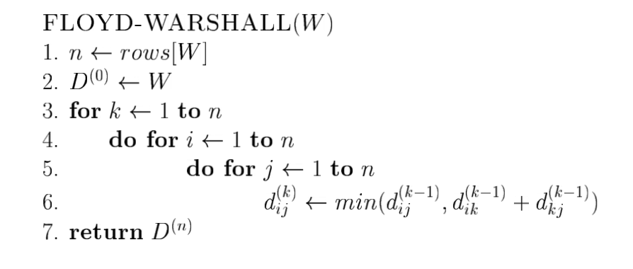
Algorithm - Pseudocode

Slide 7
Algorithm - Complexity
Time Complexity - O(n³)

Slide 8

Advantages
Find the transitive closure of directed graphs
Optimal in dense graphs with few vertices
Works with negative edge weights

Slide 9
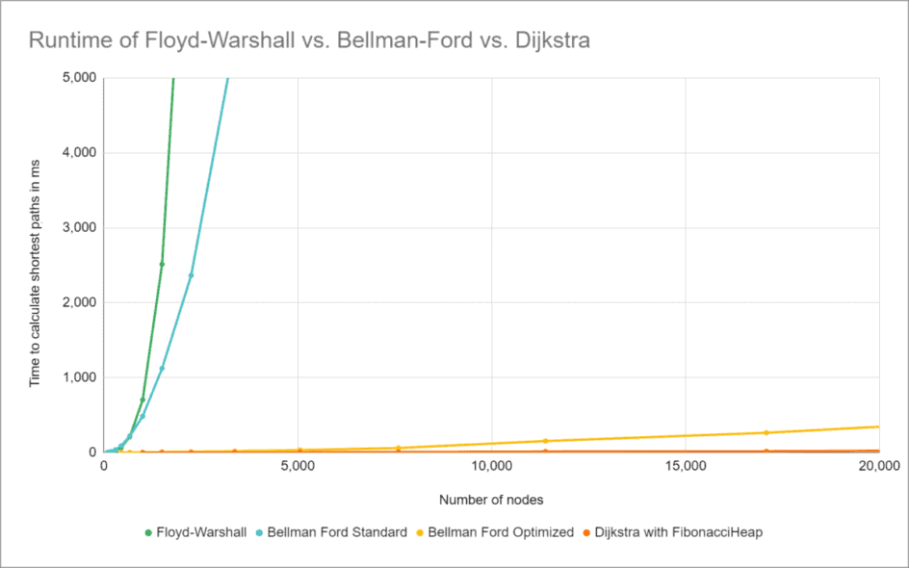
Disadvantages
Slower than Dijkstra or Bellman-Ford for certain use cases
Can’t work with negative cycles
Does not return details of the shortest path
Floyd-Warshall should only be used when shortest paths between all nodes are required

Slide 10

Summary
Overall, the Floyd-Warshall algorithm is a powerful tool for finding the shortest paths between all pairs of vertices in a weighted graph, and is widely used in computer science and other fields.

Slide 11

THANK YOU!

